Slide 1


OPEN
DATA
SCIENCE
CONFERENCE
@ODSC
Boston | April 30 - May 4, 2019

Slide 2
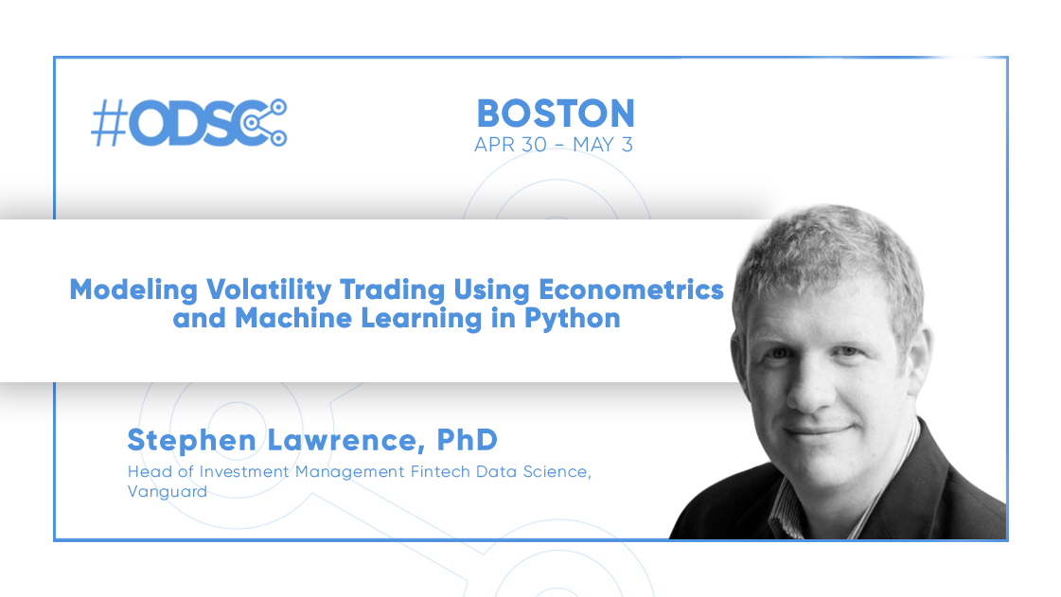

Slide 3
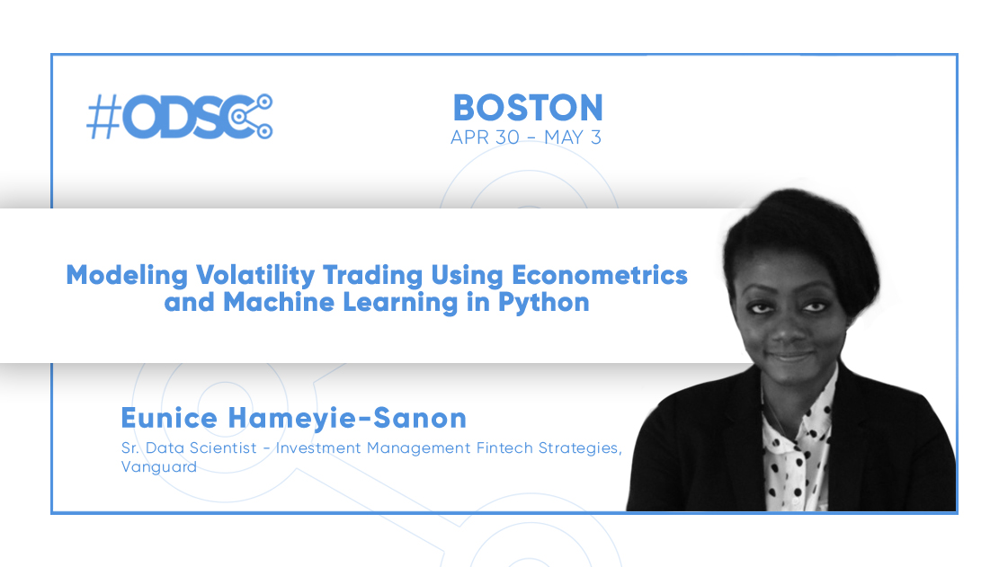

Slide 4
Important Information
The opinions and materials presented in this training session are solely those of the authors and do not represent those of The Vanguard Group or its affiliates.
All code and materials are purely for informational and illustrative purposes. They should not be considered investment advice and come with no warranty.
You are using this code at your own risk.

Slide 5

Prerequisites for the Training Workshop
To access the materials in this presentation, please visit:
https://github.com/fintechsteve/modeling-volatility
To successfully complete this training you will need either:
Python with Jupyter Notebooks (e.g. Anaconda)
-or-
An account on Google Colab
Packages used include: pickle, cloudpickle, numpy, pandas, matplotlib, seaborn, scipy and bashtage/arch

Slide 6
Workshop Overview and Timeline
0900 – 0915 Introductions, Setting up the environment and project background
0915 – 0945 Part 1: Working with return data in Python Eunice Part 2: Visualizing Timeseries Data
0945 – 1000 Part 3: Setting up the Modeling Framework Steve
1000 – 1030 Part 4a: Understanding Turbulence Signals Steve Part 4b: Creating Turbulence Models
1030 – 1100 Break
1100 – 1145 Part 5a: Understanding GARCH Estimation Steve Part 5b: Creating GARCH Models
1145 – 1230 Part 6a: Direct attempts at machine learning Eunice Part 6b: Combining methods Steve
1230 – 1300 Conclusion and Q&A Steve/Eunice

Slide 7

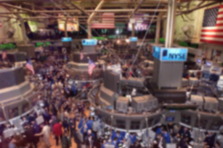

Who is this Presentation For?
Candidate Student #1: Data Scientist with minimal Python experience looking to:
Better understand how financial modelers think
Learn traditional financial/econometric modeling techniques for volatility
Understand the nuances that differentiate data science and trading model development
Candidate Student #2: Finance professional with minimal data science experience looking to:
Learn how to make the transition from Matlab to Python
Learn how to leverage financial domain knowledge to better empower data science
Avoid the pitfalls casual quants make when leveraging more powerful modeling techniques

Slide 8
Setting Up Your Environment
If running on Google Colab, ensure you have a Google account then click on the “Open in Colab” link in the top of each notebook to get started.
Alternatively:
Register for Github and clone the project: git clone https://github.com/fintechsteve/modeling-volatility
Create a new environment (if you don’t have it, now is a good time to get from anaconda.org) conda create -n odsc-volatility python=3.6 source activate odsc-volatility pip install -r requirements.txt
Launch Jupyter Notebooks: jupyter notebook
If successful, you should be able to run the commands for Part 1 in your browser.

Slide 9
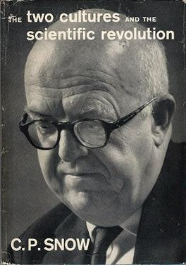
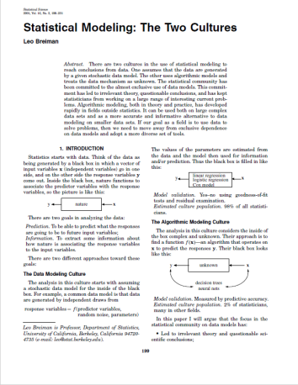
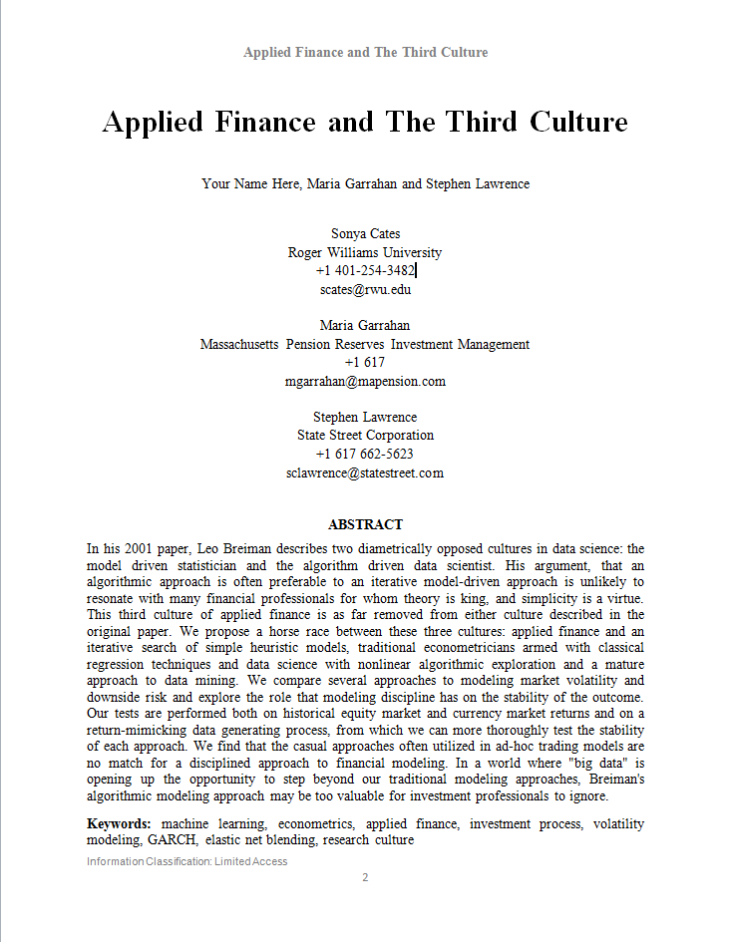
Background (While People Get Their Python Environments Set Up!)
Why “The Third Culture”?
In 1959, C.P. Snow wrote an essay titled “The Two Cultures” where he observed a general scientific illiteracy among otherwise educated individuals.
He upset many with his comments – ultimately John Brockman wrote in 1995 about “The Third Culture” serving as a mediator.
In 2001, Leo Breiman wrote an essay titled “Statistical Modeling: The Two Cultures” where he pitted traditional statisticians and their models against data scientists and their algorithmic exploration.
Statistical Science published rebuttal commentary by D.R. Cox and Brad Efron accompanying Breiman’s article.
Working in finance, this “fight” between statisticians and data scientists is almost comical!
Professor Sonya Cates (AI professor and former State Street), Maria Garrahan (Investment professional), and Stephen Lawrence co-authored a paper “Applied Finance and The Third Culture”
Image Sources: https://en.wikipedia.org/wiki/File:TheTwoCultures.jpg
https://projecteuclid.org/download/pdf_1/euclid.ss/1009213726
Cates, Garrahan and Lawrence, 2018, Applied Finance and the Third Culture

Slide 10
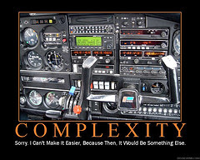
The Intricacy of Simple Financial Models
“Machine learning at its core is based on inherently simple concepts
Modern finance is built on decades of intricate modeling”
Common financial tools including most time series modeling techniques incorporate significant nuance into their design.
Unless this nuance is captured in inputs into machine learning, it will not compete.
A compromise is to incorporate financial models and tools as inputs into machine learning models – let ML optimize across models.
Image Source: Office.com. All quotes from Lawrence, Cates and Garrahan (2017), Applied Finance: The Third Culture, Working Paper

Slide 11
Our Currency Volatility Model
We are interested in predicting tomorrow’s currency volatility.
Specifically, we want to predict the volatility of the following 24hr return on a DXY basket
(DXY is a weighted basket of 6 currencies against the dollar)
We have past returns available to us for 9 currencies against the dollar
Our goal is to construct a model that assigns a low weight (close to 0) when volatility is likely to be high and a high weight (close to 1) when volatility is likely to be low.

Slide 12
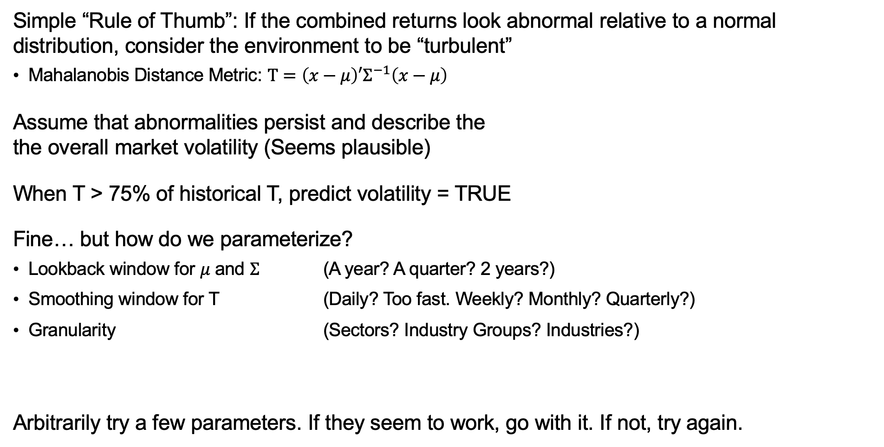
Introduction to Turbulence
Simple “Rule of Thumb”: If the combined returns look abnormal relative to a normal distribution, consider the environment to be “turbulent”
Mahalanobis Distance Metric: $T=\left(x−μ\right)′Σ^{−1}\left(x−μ\right)$
Assume that abnormalities persist and describe the the overall market volatility (Seems plausible)
When T > 75% of historical T, predict volatility = TRUE
Fine… but how do we parameterize?
Lookback window for $μ$ and $Σ$ (A year? A quarter? 2 years?)
Smoothing window for T (Daily? Too fast. Weekly? Monthly? Quarterly?)
Granularity (Sectors? Industry Groups? Industries?)
Arbitrarily try a few parameters. If they seem to work, go with it. If not, try again.

Slide 13
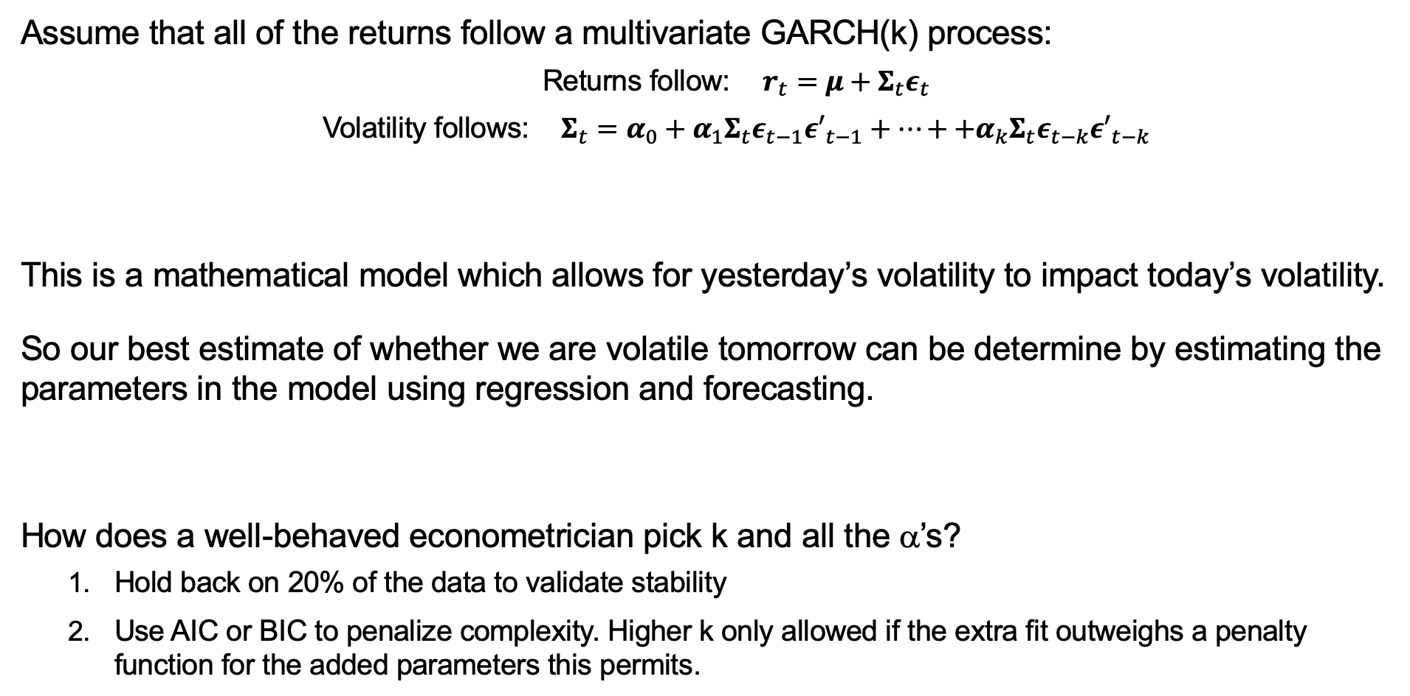
The GARCH Approach
Assume that all of the returns follow a multivariate GARCH(k) process:
Returns follow: $r_{t}=μ+Σ_{t}ε_{t}$
Volatility follows: $Σ_{t}=α_{0}+α_{1}Σ_{t}ε_{t−1}{ε′}_{t−1}+…++α_{k}Σ_{t}ε_{t−k}{ε′}_{t−k}$
This is a mathematical model which allows for yesterday’s volatility to impact today’s volatility.
So our best estimate of whether we are volatile tomorrow can be determine by estimating the parameters in the model using regression and forecasting.
How does a well-behaved econometrician pick k and all the α’s?
Hold back on 20% of the data to validate stability
Use AIC or BIC to penalize complexity. Higher k only allowed if the extra fit outweighs a penalty function for the added parameters this permits.

Slide 14
The Data Science Approach
An algorithmic approach doesn’t care about the specific economic model, just observed data
Various variables derived from squared lagged returns likely to be features
e.g. In a boosted tree method, certain combinations of conditions on features are proposed.
Model is optimized over an intelligent search of potential candidate decision rules.
How do you prevent this from becoming a data-mining disaster?
Quick answer: Commit to one run with estimation and holdback data:
20% is held back for the modeler to validate
Remaining 80% partitioned into 5x16% chunks
Each trial uses 4 chunks to estimate
The remaining chunk is used to validate
The model with the most stable validation win
Trial 1
Estimation (64%)
Holdback Data (20%)
Trial 2
Trial 3
Trial 4
Trial 5
Estimation (64%)
Image source: State Street Global Exchange
GXN-4575

Slide 15
Workshop Overview and Timeline
0900 – 0915 Introductions, Setting up the environment and project background
0915 – 0945 Part 1: Working with return data in Python Eunice Part 2: Visualizing Timeseries Data
0945 – 1000 Part 3: Setting up the Modeling Framework Steve
1000 – 1030 Part 4a: Understanding Turbulence Signals Steve Part 4b: Creating Turbulence Models
1030 – 1100 Break
1100 – 1145 Part 5a: Understanding GARCH Estimation Steve Part 5b: Creating GARCH Models
1145 – 1230 Part 6a: Direct attempts at machine learning Eunice Part 6b: Combining methods Steve
1230 – 1300 Conclusion and Q&A Steve/Eunice

Slide 16
Workshop Overview and Timeline
0900 – 0915 Introductions, Setting up the environment and project background
0915 – 0945 Part 1: Working with return data in Python Eunice Part 2: Visualizing Timeseries Data
0945 – 1000 Part 3: Setting up the Modeling Framework Steve
1000 – 1030 Part 4a: Understanding Turbulence Signals Steve Part 4b: Creating Turbulence Models
1030 – 1100 Break
1100 – 1145 Part 5a: Understanding GARCH Estimation Steve Part 5b: Creating GARCH Models
1145 – 1230 Part 6a: Direct attempts at machine learning Eunice Part 6b: Combining methods Steve
1230 – 1300 Conclusion and Q&A Steve/Eunice

Slide 17
Important Lessons When Setting Up A Trading Model Backtest
Always test your framework with random signals and random returns to help ensure your framework is wrong – Assume you misaligned something and prove to yourself you didn’t
Start worrying early about the constraints you need your model to have – incorporating them into the data science early will help align your evaluation metrics.
Think about ways of reducing the risk of bias in your model.
Or appropriately benchmark it to account for the bias.

Slide 18
Workshop Overview and Timeline
0900 – 0915 Introductions, Setting up the environment and project background
0915 – 0945 Part 1: Working with return data in Python Eunice Part 2: Visualizing Timeseries Data
0945 – 1000 Part 3: Setting up the Modeling Framework Steve
1000 – 1030 Part 4a: Understanding Turbulence Signals Steve Part 4b: Creating Turbulence Models
1030 – 1100 Break
1100 – 1145 Part 5a: Understanding GARCH Estimation Steve Part 5b: Creating GARCH Models
1145 – 1230 Part 6a: Direct attempts at machine learning Eunice Part 6b: Combining methods Steve
1230 – 1300 Conclusion and Q&A Steve/Eunice

Slide 19
Introduction to Turbulence
Simple “Rule of Thumb”: If the combined returns look abnormal relative to a normal distribution, consider the environment to be “turbulent”
Mahalanobis Distance Metric: $T=\left(x−μ\right)′Σ^{−1}\left(x−μ\right)$
Assume that abnormalities persist and describe the the overall market volatility (Seems plausible)
When T > 75% of historical T, predict volatility = TRUE
Fine… but how do we parameterize?
Lookback window for $μ$ and $Σ$ (A year? A quarter? 2 years?)
Smoothing window for T (Daily? Too fast. Weekly? Monthly? Quarterly?)
Granularity (Sectors? Industry Groups? Industries?)
Arbitrarily try a few parameters. If they seem to work, go with it. If not, try again.

Slide 20
Estimation Samples in the Turbulence Model
Lookback Window
Turbulence is estimated with a rolling window
Estimates over the period 1/1/1975 – 12/31/1994 are used to determine the optimal weighting scheme
1/1/1995 – 12/31/2004 is used to choose model parameters
1/1/2005 – 12/26/2017 is used as out-of-sample holdback to assess model fit
Lookback Window
Lookback Window
Lookback Window
Estimation and Weighting
Model Tuning
Estimation and Weighting
Model Tuning
Holdback / OOS
Photo by Unknown Author is licensed under CC BY-SA

Slide 21
Important Note
This workshop explains topics incrementally
As such, we keep revisiting the same “holdback” period with different models.
This is not acceptable!
But it would be even more confusing if we waited until the end for the reveal!
Photo by Unknown Author is licensed under CC BY-SA

Slide 22

Issues to avoid when creating a model
Using future information in today’s estimation
Using 100% of the sample to estimate model parameters
Choosing parameters based solely on in-sample performance
Over-reliance on history being the best model of the future and lack of holdback discipline
Estimation (100%)
Photo by Unknown Author is licensed under CC BY-SA

Slide 23
Workshop Overview and Timeline
0900 – 0915 Introductions, Setting up the environment and project background
0915 – 0945 Part 1: Working with return data in Python Eunice Part 2: Visualizing Timeseries Data
0945 – 1000 Part 3: Setting up the Modeling Framework Steve
1000 – 1030 Part 4a: Understanding Turbulence Signals Steve Part 4b: Creating Turbulence Models
1030 – 1100 Break (Start promptly at 1100)
1100 – 1145 Part 5a: Understanding GARCH Estimation Steve Part 5b: Creating GARCH Models
1145 – 1230 Part 6a: Direct attempts at machine learning Eunice Part 6b: Combining methods Steve
1230 – 1300 Conclusion and Q&A Steve/Eunice

Slide 24
Workshop Overview and Timeline
0900 – 0915 Introductions, Setting up the environment and project background
0915 – 0945 Part 1: Working with return data in Python Eunice Part 2: Visualizing Timeseries Data
0945 – 1000 Part 3: Setting up the Modeling Framework Steve
1000 – 1030 Part 4a: Understanding Turbulence Signals Steve Part 4b: Creating Turbulence Models
1030 – 1100 Break
1100 – 1145 Part 5a: Understanding GARCH Estimation Steve Part 5b: Creating GARCH Models
1145 – 1230 Part 6a: Direct attempts at machine learning Eunice Part 6b: Combining methods Steve
1230 – 1300 Conclusion and Q&A Steve/Eunice

Slide 25
The GARCH Approach
Assume that all of the returns follow a multivariate GARCH(k) process:
Returns follow: $r_{t}=μ+Σ_{t}ε_{t}$
Volatility follows: $Σ_{t}=α_{0}+α_{1}Σ_{t}ε_{t−1}{ε′}_{t−1}+…++α_{k}Σ_{t}ε_{t−k}{ε′}_{t−k}$
This is a mathematical model which allows for yesterday’s volatility to impact today’s volatility.
So our best estimate of whether we are volatile tomorrow can be determine by estimating the parameters in the model using regression and forecasting.
How does a well-behaved econometrician pick k and all the α’s?
Hold back on 20% of the data to validate stability
Use AIC or BIC to penalize complexity. Higher k only allowed if the extra fit outweighs a penalty function for the added parameters this permits.

Slide 26
Workshop Overview and Timeline
0900 – 0915 Introductions, Setting up the environment and project background
0915 – 0945 Part 1: Working with return data in Python Eunice Part 2: Visualizing Timeseries Data
0945 – 1000 Part 3: Setting up the Modeling Framework Steve
1000 – 1030 Part 4a: Understanding Turbulence Signals Steve Part 4b: Creating Turbulence Models
1030 – 1100 Break
1100 – 1145 Part 5a: Understanding GARCH Estimation Steve Part 5b: Creating GARCH Models
1145 – 1230 Part 6a: Direct attempts at machine learning Eunice Part 6b: Combining methods Steve
1230 – 1300 Conclusion and Q&A Steve/Eunice

Slide 27
Workshop Overview and Timeline
0900 – 0915 Introductions, Setting up the environment and project background
0915 – 0945 Part 1: Working with return data in Python Eunice Part 2: Visualizing Timeseries Data
0945 – 1000 Part 3: Setting up the Modeling Framework Steve
1000 – 1030 Part 4a: Understanding Turbulence Signals Steve Part 4b: Creating Turbulence Models
1030 – 1100 Break
1100 – 1145 Part 5a: Understanding GARCH Estimation Steve Part 5b: Creating GARCH Models
1145 – 1230 Part 6a: Direct attempts at machine learning Eunice Part 6b: Combining methods Steve
1230 – 1300 Conclusion and Q&A Steve/Eunice

Slide 28


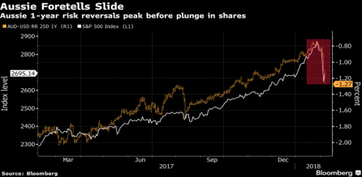
The Motivation Behind Applied Finance
Finance Relies on Heuristics and Instinct
Finance is Often About Telling Stories
Computing power has lagged need, particularly in live visualization.
Understanding WHY is more important than WHAT (even if loss of accuracy).
Human reaction time is critical.
Often there is no time (or budget) for “nerdy” backtesting.
The sell side needs to find a simple model that explains recent history.
A buy side modeler needs investors to understand their strategy (no black boxes).
Regulators and auditors need to understand how a risk model works.
Each has an impact on how data science is applied in finance.

Slide 29
Parting Thoughts
Machine Learning and Artificial Intelligence provide powerful tools to derive insight faster and more efficiently than traditional methods.
Different models have varying appeal to differing problems.
The culture of the organization will impact the extent to which a pure data science approach can be tolerated.
With the prevalence of big, unstructured data, a data science approach is going to become more and more necessary in finance.
Understanding your experience path can help guide your approach to data science
GXN-4575

